Slide 1



Solution Overview
OE List
Service Level Management |Portfolio Overview

Slide 2
Solution Overview
Portfolio view
Service Level Management |Portfolio Overview | DE
ABS Projects
Disabled
Disabled
Disabled

Slide 3
Solution Overview
Project view
Service Level Management |Portfolio Overview | DE
ABBS
Disabled
Disabled
Disabled

Slide 4
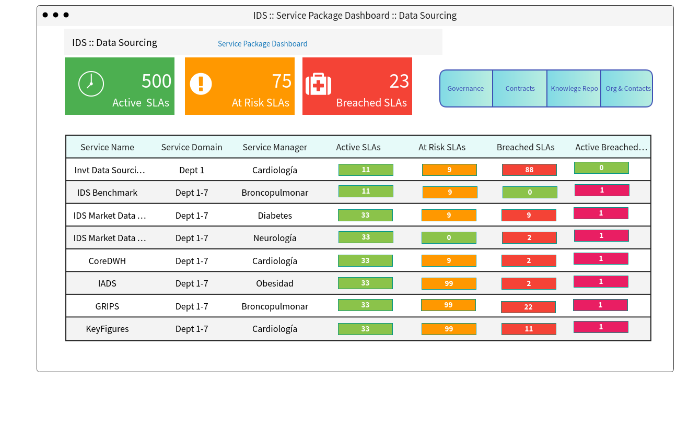
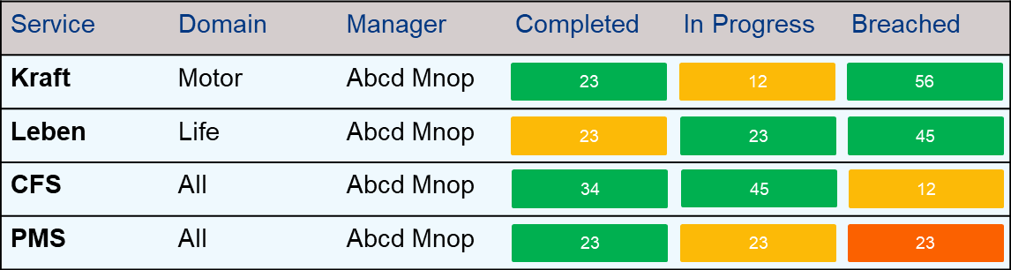
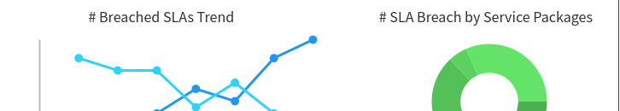
ABBS DASHBOARD :: Data sourcing
Service Package level
Service Level Management |Portfolio Overview | DE
ABBS :: Service Package Dashboard :: Data Sourcing
ABBS :: Data Sourcing

Slide 5
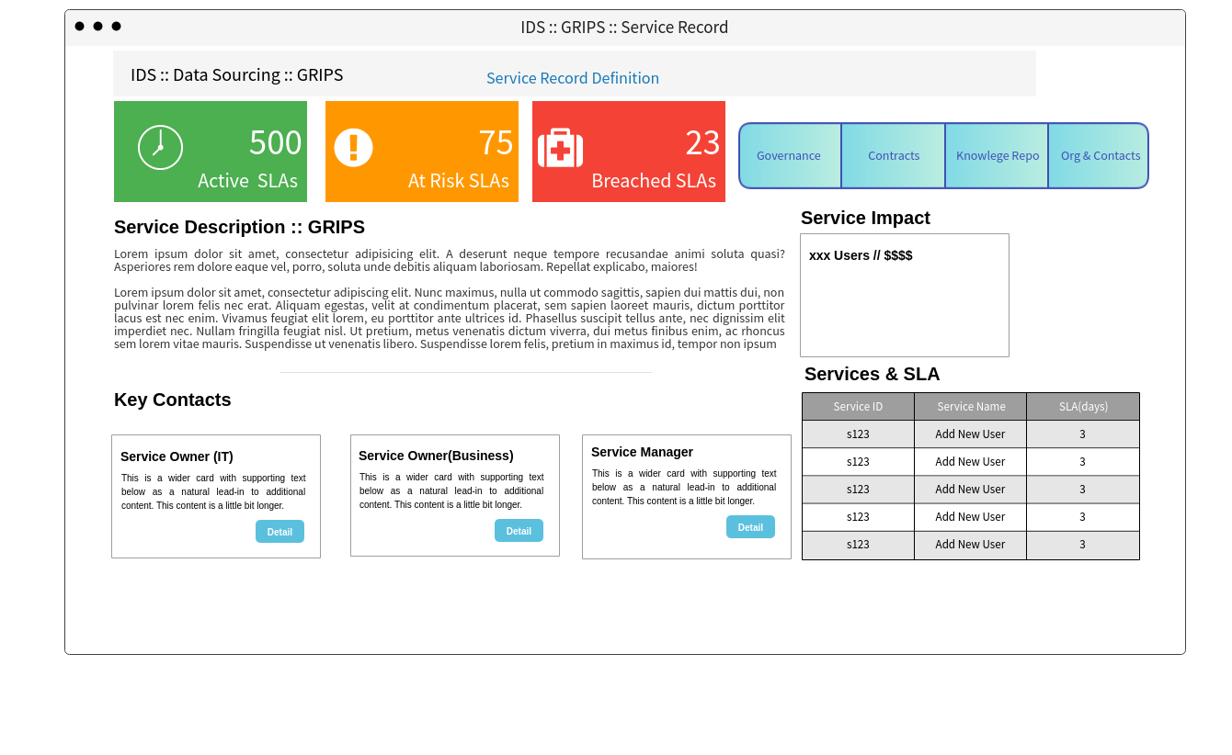
ABBS :: Data sourcing :: PMS
Service Record level
Service Level Management |Portfolio Overview | DE
ABBS :: PMS :: Service Record
ABBS :: Data Sourcing :: PMS
Service Description :: PMS
Service Record1 | Owner(IT) | Owner(Business) | Service Owner | Documents

Slide 6
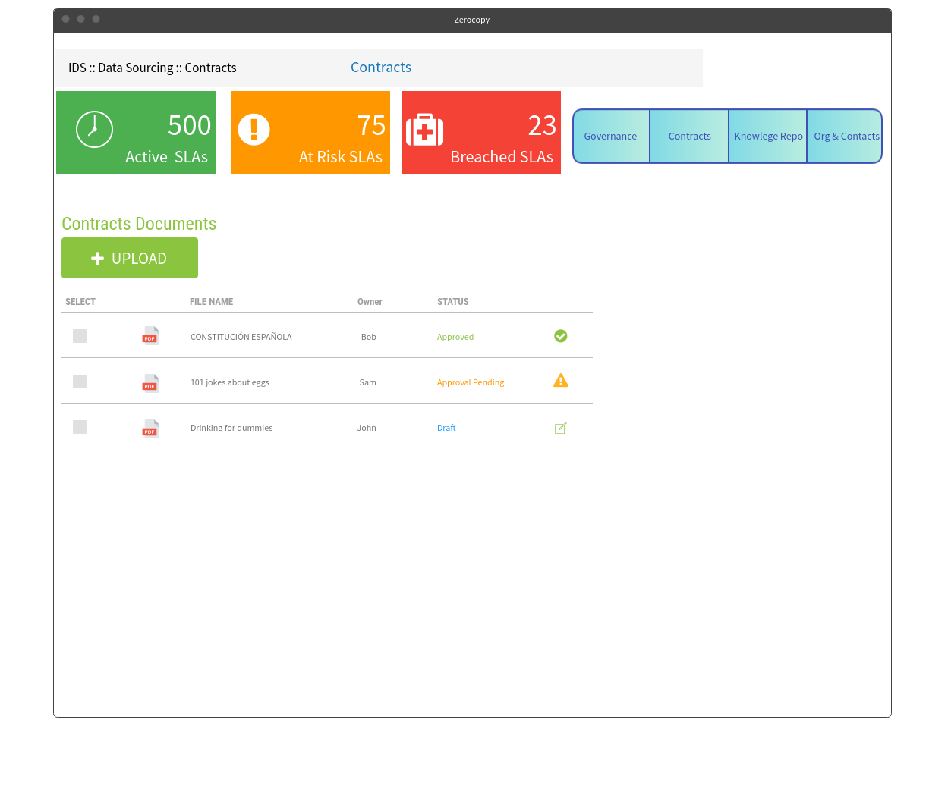
ABBS :: Data sourcing :: PMS :: Documents
Service Record level
Service Level Management |Portfolio Overview | DE
ABBS :: PMS :: Service Record
ABBS :: Data Sourcing :: PMS

